Slide 1
RepQuest Project Design
Dylan Hulon, Austin Jones, Benjamin Johnson, Jaylen Cook

Slide 2
We are RepQuest!! (Agenda)
We will be discussing the design architecture of RepQuest.
Or in other words, how the application will be designed.
We will also be discussing how the application will function.
We will be discussing and presenting subject matters about the,
Gamification
Block Diagram
Component Diagram
Entity-Relationalship Diagram (ERD)
User Interface (or StoryBoard)
Storage Documentation

Slide 3
Basic Description (refresher)
To begin, RepQuest will be an application that runs on Android that allows the user to create workout templates, upload workouts, and monitor their progress, history, statistics, and goals!
In addition to this, we plan to implement a gamification layer to the application that includes a small avatar to represent the user. The goal of this is to help enhance the user’s overall experience of the application!

Slide 4

Gamification Layer
The gamification layer will enhance the user’s experience, and appeal to different groups of individuals.
Where the user, achieves goals, will earn experience points(EXP) and have an avatar that represents the users!

Slide 5
Block Diagram
The block diagram describes the three main component of the application.
The Firebase Server & Database,
The local/network connection layer,
The User Interface layer
Firebase Server & Database
Firebase database that retrieves and stores data.
Firebase server that handles the requests to retrieve and store data from the database.
Data Syncing
Data can be synced over WiFi or a service provider internet (cell phone service)
Data is then uploaded and downloaded periodically.

Slide 6
Component Diagram
The component diagram shows the main components and how they function together within the application.
Begins with the starting of the application and pulling/uploading saved data from Firebase Server & Database.
The User Interface is then next seen where the user can either begin a workout, edit/create templates, view history, statistics, and or goals.
The gamification of the application will reward the user experience points (EXP) and updates their history, statistics, and goals.

Slide 7
Component Diagram (2)
To go further into detail, if the user begins a workout, the user goes through the user interface to begin.
Once the workout is completed,
If there are any goals hit or experience points earned those are logged within the History/Statistics/Goal location of the user Interface.
The information is then uploaded to the database for storage, and can be retrieved later for viewing (history tab).
Or the user can save the workout and create their own template!
If they don’t like that workout later, it can be removed and or changed through the user interface.

Slide 8
ERD (Entity-Relationship Diagram)
The Entity-Relationship Diagram illustrates the interaction between the three main components of the application.
Each individual user can have one or more exercises and one or more workouts.
Their primary key is the user id (int)
Each individual exercise is included in one or more workouts, but belongs to only one user.
Its primary key is the exercise id (int)
Its foreign key is the user id (int)
Its other attributes are exercise name (up to 20 chars), unit of completion, number of sets (int), and rest period length (int)
Each individual workout contains one or more exercises, but belongs to only one user.
Its primary key is the workout id (int)
Its foreign keys are the user id and exercise id (int)
Its other attributes are workout notes (up to 200 chars) and bodyweight (int)

Slide 9
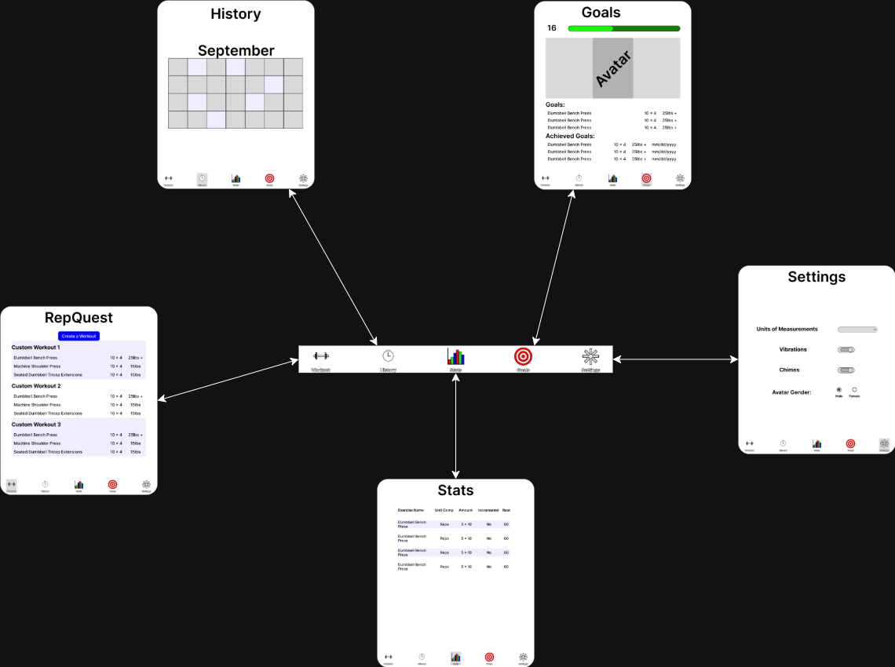
User Interface (Navbar)
Use the Navbar to switch between the “main” pages.

Slide 10
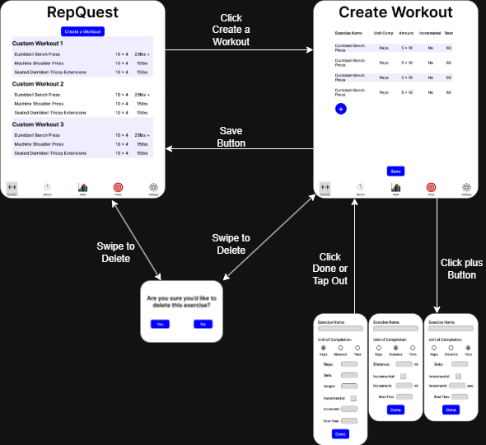

User Interface (Create Workout)
Click Create a Workout to get started
Swipe on an existing template to delete
Confirmation box will appear
Click the “+” button to add an exercise
Information will change depending on the exercise
Swipe to delete an exercise
Confirmation box will appear

Slide 11
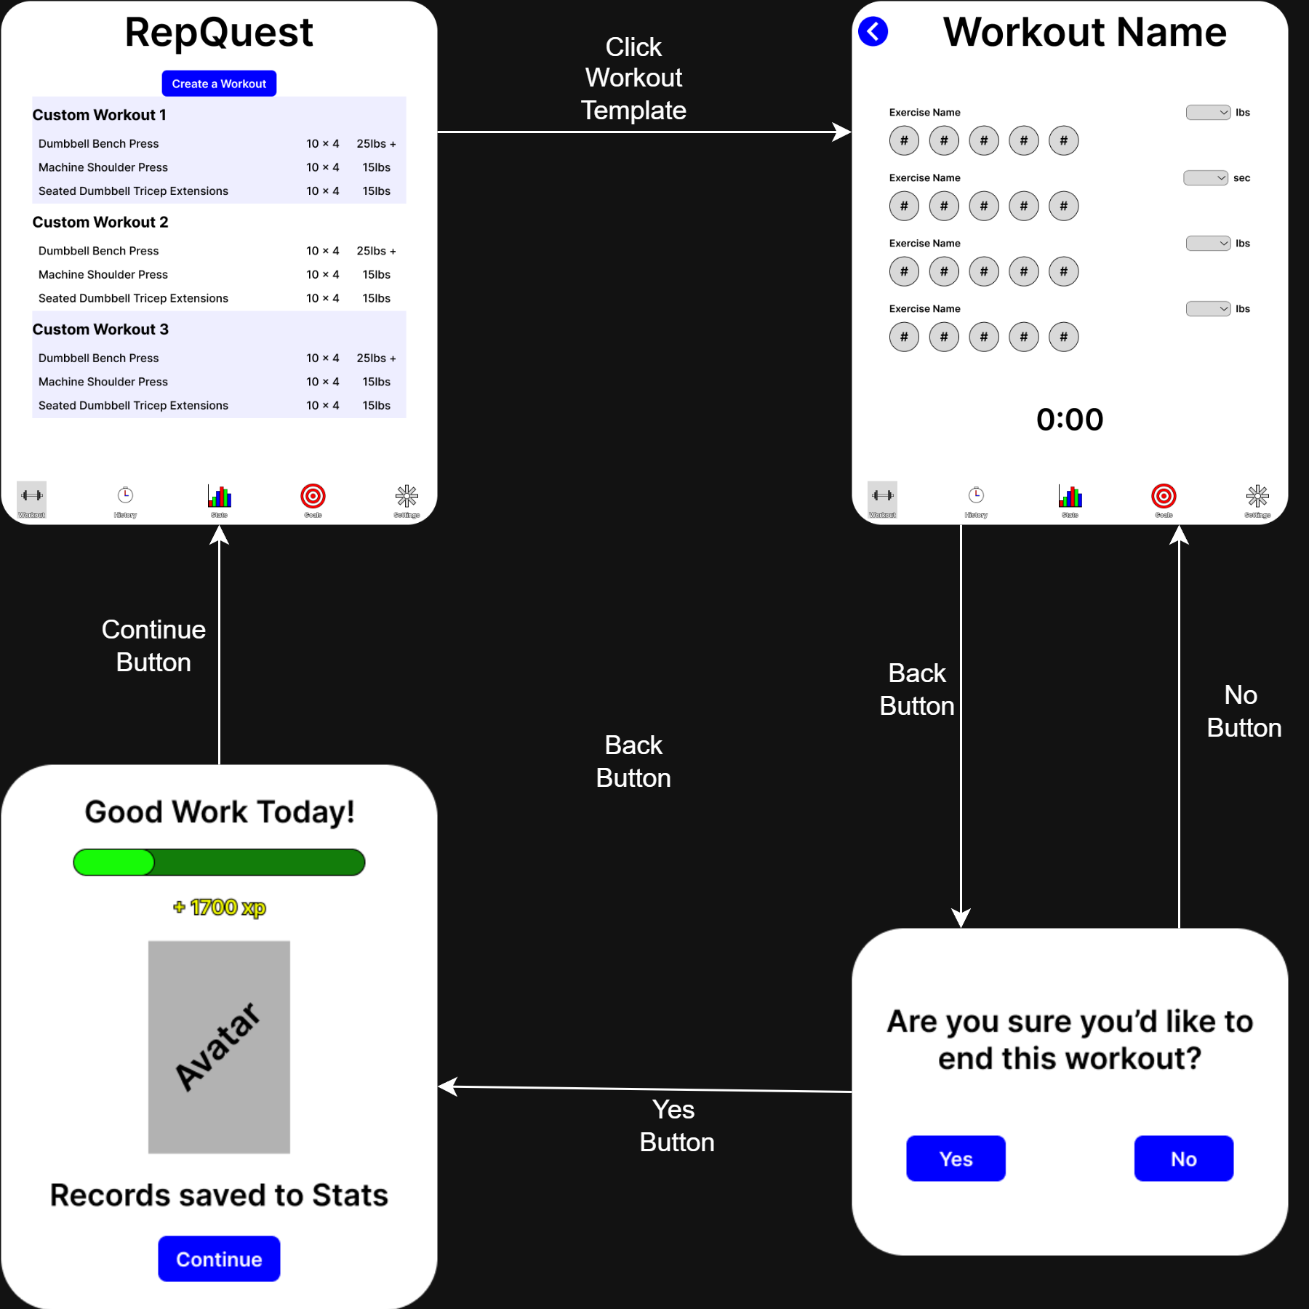
User Interface (Workout)
Click a template to start a Workout
Each Exercise has 1 completion bubble per set entered
Tap once to mark set complete, tap again to lower the number
Press the back button to quit
Confirmation box will appear
Confirming will send you to the experience screen

Slide 12
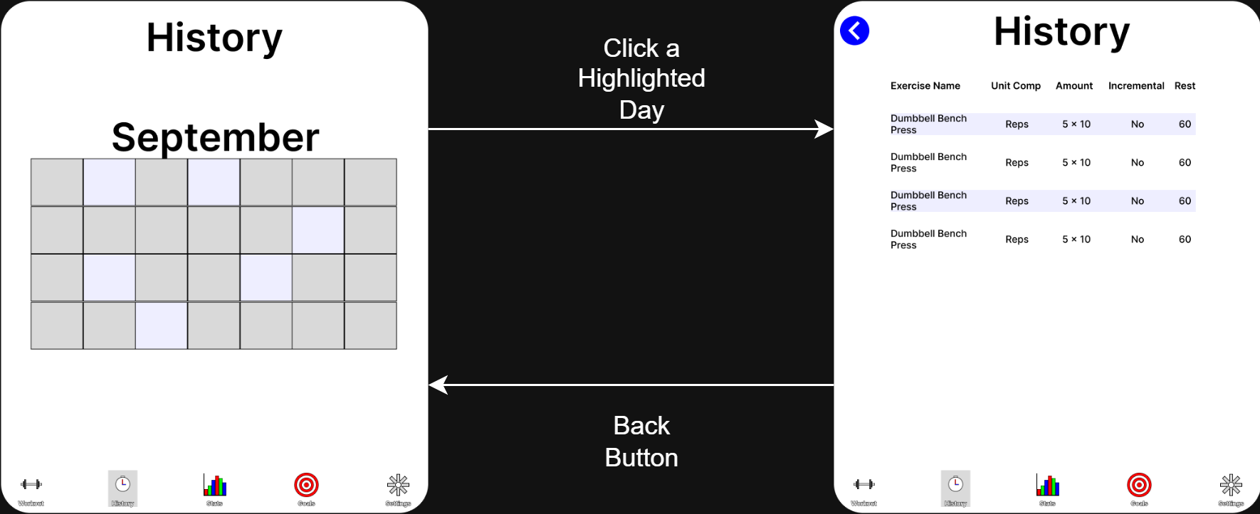
User Interface (History)
Click on a highlighted day to see the exercises and notes you have saved for that day

Slide 13
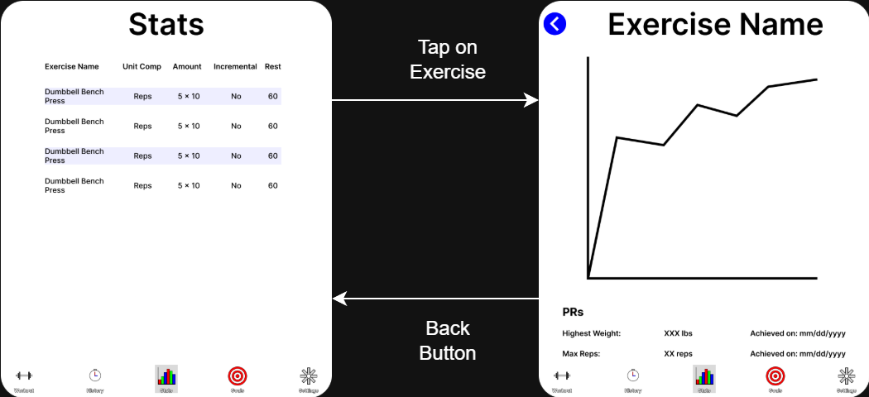
User Interface (Stats)
Click on an exercise to see how you’ve performed on an exercise over time

Slide 14
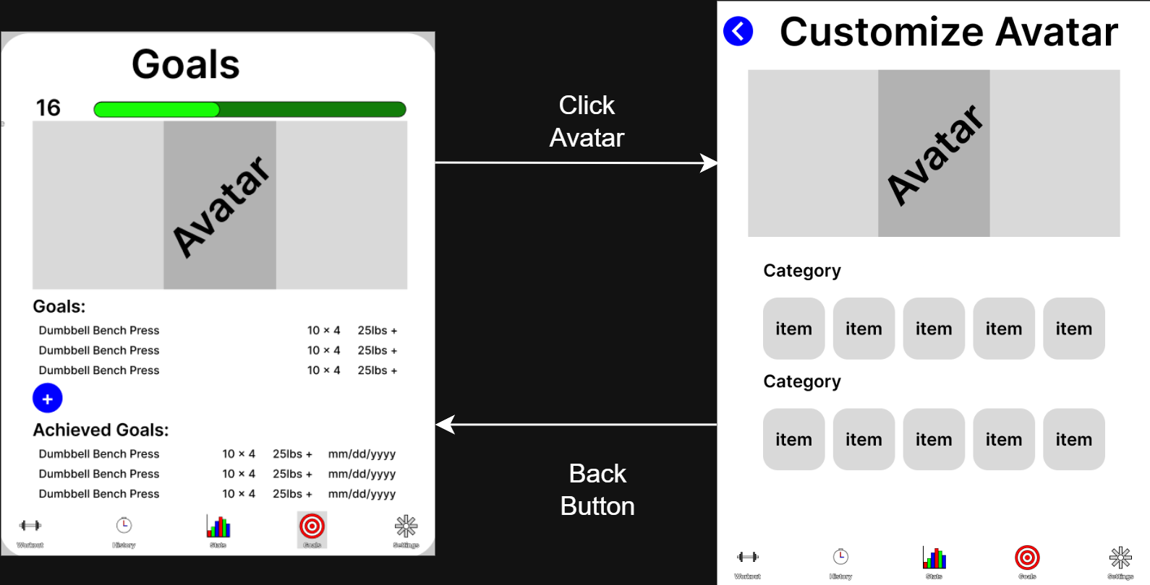
User Interface (Goals)
Here you can check and add goals you’ve made for each exercise
You can also change your avatar

Slide 15
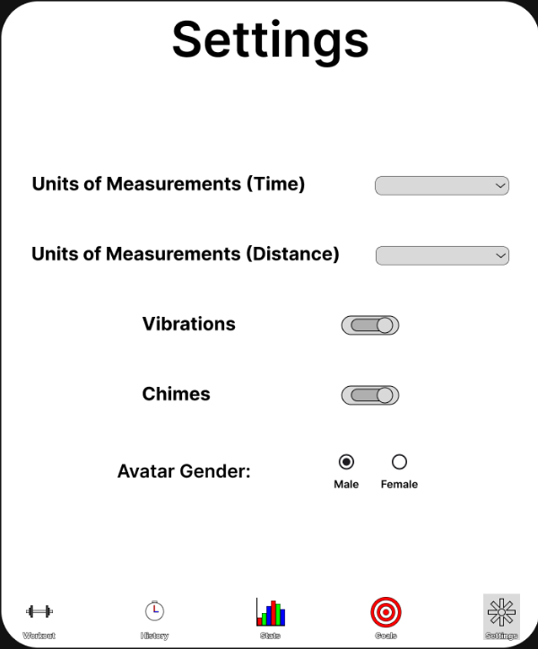
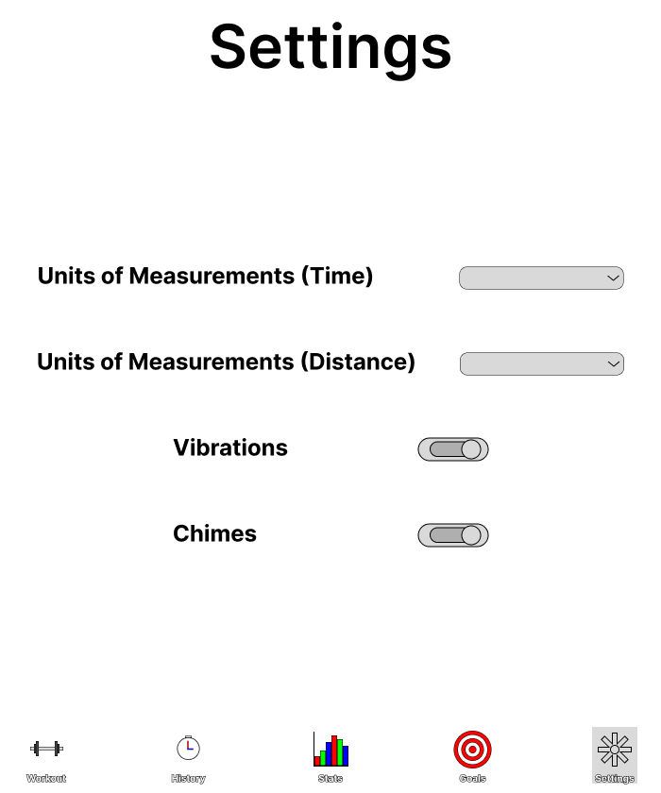
User Interface (Settings)
Change various settings
Unit of measurements
Vibrations
Chimes

Slide 16
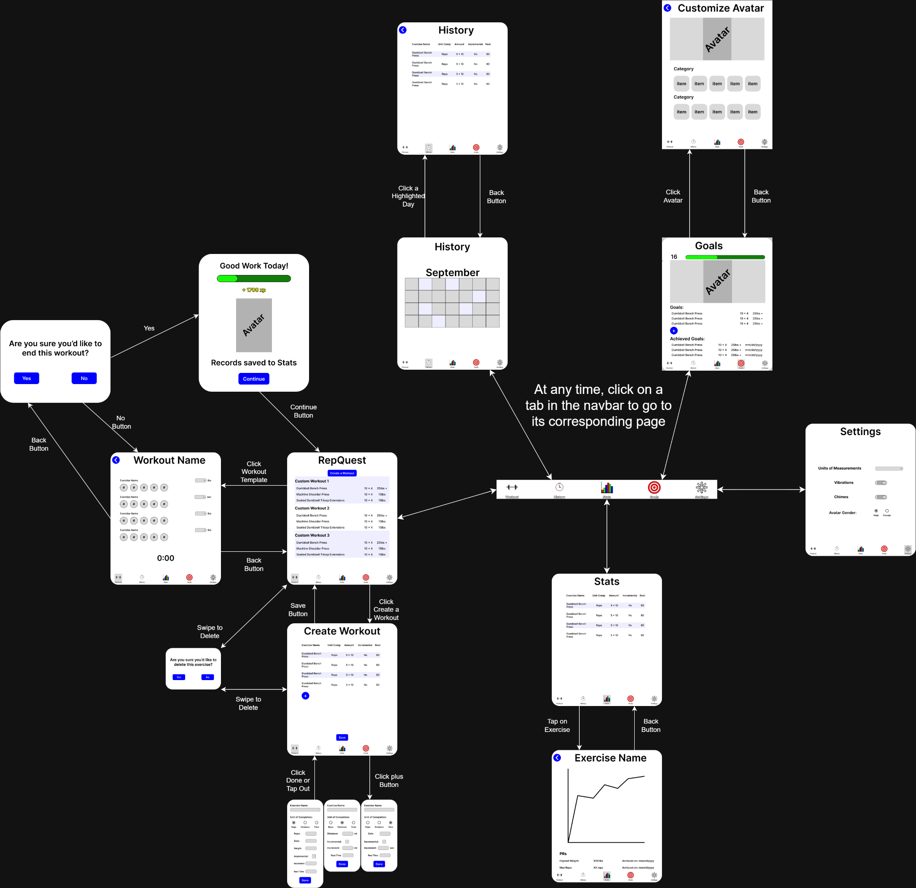
User Interface (Main)

Slide 17
Storage
RepQuest will be using Firebase Database and Firebase Server.
Firebase Database will store the data of the user.
Such as, templates, experience points, workouts, goals, history, and statistics.
Firebase Server will handle the authentication of the component layers.
Such as,
Syncing user data and the database.
Upload/download new templates/workouts, exp, goals, stats.
Provides real time synchronization of information.
Helps keep the database up to date.
The user will also be given the option to permit upload/download over Wi-Fi only or allow upload/download over a connection(service provider verizon, AT&T)

Slide 18
Summary (Closing)
To begin our closeout, the goal of RepQuest is intended to help user’s enjoy working out with the help of a user-friendly interface that includes an avatar!
RepQuest allows for data to be uploaded and downloaded periodically with the use of Firebase Database & Firebase Server.
Workouts, templates, goals and statistics are stored and synced in real time.
Gamification rewards users with EXP and avatar updates to encourage progress.

Slide 19
Thank you all for your time!
-RepQuest

